Slide 1

DIGITAL PORTFOLIO
STUDENT NAME:
S SARANRAJ
REGISTERNO /NMID:asunm1397222406203 DEPARTMENT: BSC computer science with data science
COLLEGE:
SRMARTSANDSCIENCECOLLEGEMADRAS UNIVERSITY
1

Slide 2

PROJECT TITLE
WHISPERS
A PORTFOLIO OF
2

Slide 3



AGENDA
1. 2. 3. 4. 5. 6. 7. 8. 9.
Problem Statement Project Overview End Users Tools and Technologies Portfolio design and Layout Features and Functionality Results and Screenshots Conclusion Github Link
3/21/2024 Annual Review
3

Slide 4


PROBLEM STATEMENT
Students and recent graduates in creative and technical fields find it difficult to stand out to employers with traditional resumes alone, as these documents fail to effectively convey their skills, project process, and personal brand. We create a dynamic and interactive digital portfolio that enables emerging talent to not just showcase their work, but also tell the story behind it, so they can make a lasting impression on recruiters and hiring managers.
4

Slide 5


PROJECT OVERVIEW
This digital portfolio showcases skills, demonstrating the process for creating user-centered digital products that solve real-world problems. It is designed to provide potential employers with a clear understanding of design thinking and technical abilities. The portfolio highlights projects that have led to improved user engagement and intuitive experiences, demonstrating the ability to translate complex challenges into effective design solutions. My digital portfolio contains about my education,soft skils,technical skills,certification and training,my personal details and contact information. Main theme of the project is to demonstrate the ability to create digital products and provide solution for the complex problems.It is to showcase achivements,talents,and skills.
5

Slide 6

WHO ARE THE END USERS?
For most personal portfolios, the creator is the sole back-end user, handling all of these tasks. For more robust or team-based projects, these specialized roles ensure the portfolio remains functional, secure, and well-managed over time 1.Content managers or editors 2.Administrators 3.Technical support 4.Data analysts
6

Slide 7

TOOLS AND TECHNIQUES
HTML :The standard markup language for creating the structure of your website, including headings, paragraphs, and sections for projects, skills, and contact information. CSS : Used to control the appearance and layout of your HTML elements, including colors, fonts, spacing, and animations. JavaScript : A programming language that adds interactivity and dynamic functionality to your website, such as image sliders, form validation, or smooth scrolling effects. Visual Studio Code : A lightweight yet powerful and highly customizable open-source editor with a vast library of extensions.
7

Slide 8

PORTFOLIO DESIGN AND LAYOUT
About Skills Education Resume Project
8

Slide 9
FEATURES AND FUNCTIONALITY
Homepage/Landing Page: Introduces a professional role and value proposition. About Me Section: A personal narrative detailing background, career goals, skills, and motivations. Include a professional photo to connect with the audience. Projects/Work Samples Section: Showcases the best work. Each project should include a title, brief description, and the role performed. Resume/CV: A downloadable PDF of the resume for recruiters.

Slide 10
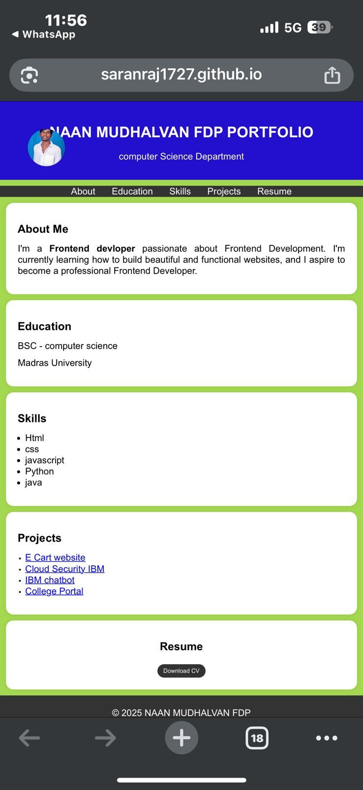

RESULTS AND SCREENSHOTS
3/21/2024 Annual Review
10

Slide 11
CONCLUSION
This digital portfolio represents the culmination of my journey through front end web development, demonstrating my growth as a student. The process of building this site with HTML, CSS, and JavaScript was a valuable exercise in not only technical development but also in critical self-reflection.
11

